Slide 1
Scatterplots
Making Connections with Data

Slide 2
What is a scatterplot?
It is a graph that has 2 independent sets of data (2 variables that do not depend on each other)
These graphs allow us to SEE if there are connections between the data

Slide 3
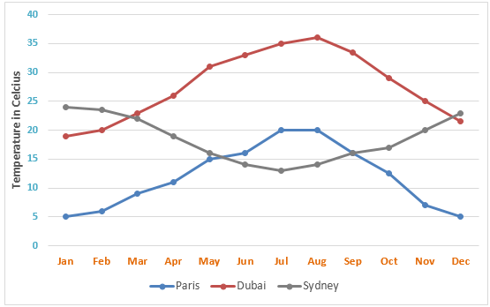
What is a scatterplot?
It is a graph that has 2 independent sets of data (2 variables that do not depend on each other)
What does this mean? TO understand this, let’s look at an example that ISN’T a scatterplot
Line Graph
Let’s think about the temperature line graph The X-axis is the independent variable (the months) – the months do not change The Y-axis is the dependent variable (what the temperature is) – this changes based on the X-axis **The month determines the temperature** Each line is a different location in the study

Slide 4
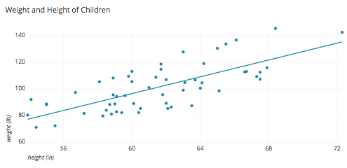
What is a scatterplot?
It is a graph that has 2 independent sets of data (2 variables that do not depend on each other)
What does this mean? Now let’s look at a scatterplot graph to understand
Scatterplot
Let’s think about this graph: The Height and Weight of Children The X-axis is an independent variable (the height of a person) – this doesn’t depend on someone’s weight The Y-axis is another independent variable (the weight of someone) – also doesn’t depend on height Each point on the graph is one of the kids used in the study
We see that even though the 2 variables don’t depend on each other (one doesn’t cause the other one to change), we can see that they are related – because the dots seem to “move” together

Slide 5
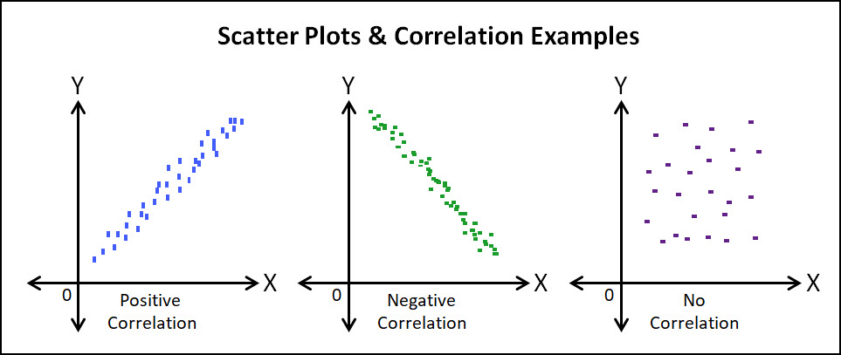
Connections between data
Correlation = connection. This tells us if one variable is likely influencing the other

Slide 6
Making our own Scatterplots
You and a partner will use Microsoft Excel to create scatterplots of your own.
We will be examining different indicators of quality of life to see if some of these are related to one another.
Each data chart below will be converted into a scatterplot graph to be analyzed.
2014 | Life Expectency (years) | Healthcare Spending (% GDP)
Country
Angola | 51.9 | 3.49
Bulgaria | 73.5 | 7.27
Canada | 81.5 | 11.18
Iran | 74.0 | 5.95
Mongolia | 67.5 | 5.26
Switzerland | 82.6 | 10.86
2013 | Years of Schooling (Children) | Employment Rate (% of Pop)
Country
Norway | 17.6 | 96.5
Canada | 15.9 | 92.9
Japan | 15.3 | 95.9
Cuba | 14.5 | 96.8
Thailand | 13.1 | 99.2
India | 11.7 | 96.3
Chad | 7.4 | 91.4
2013 | Years of Schooling (Children) | Literacy Rate (% ppl over 15)
Country
Norway | 17.6 | 100
Canada | 15.9 | 99
Japan | 15.3 | 99
Cuba | 14.5 | 100
Thailand | 13.1 | 96
India | 11.7 | 69
Chad | 7.4 | 38

